Slide 1
Tackling Inequalities in Screening
Sarah Manson
National Screening Programmes – Policy Lead

Slide 2
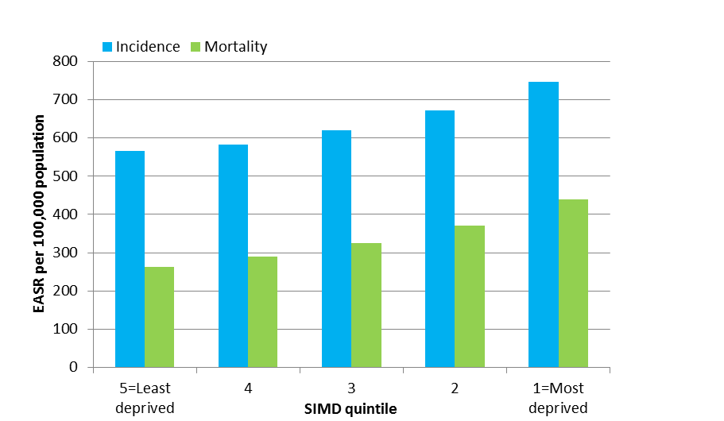
Scottish Snapshot
International Cancer Benchmarking Project: 5 year colorectal % cancer survival rates (similar findings for other cancer types)
Cancer Incidence (2009-2013) and Mortality (2010-2014) by deprivation quintile in Scotland. Age-standardised rates. (EASR: European Age Standardised Rate – using ESP2013)

Slide 3
Detect Cancer Early

Slide 5
Bowel Screening

Slide 6
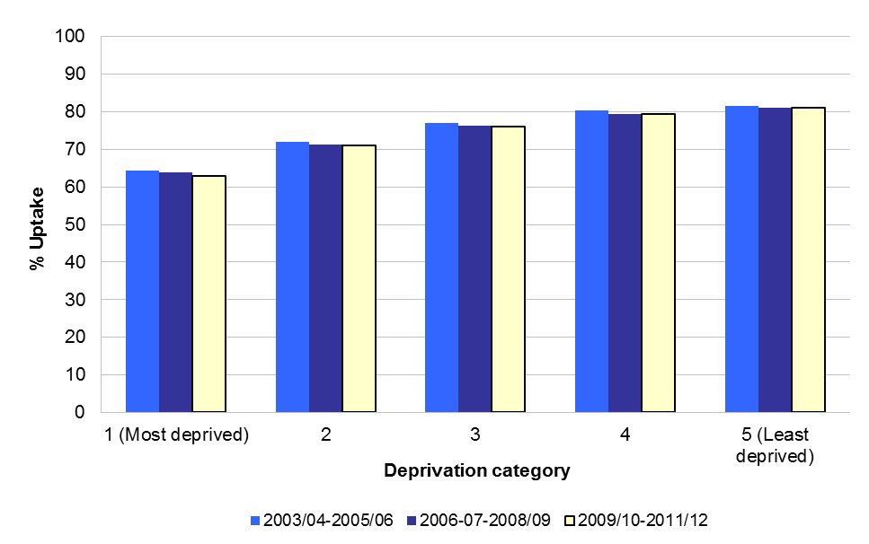
Breast screening

Slide 7
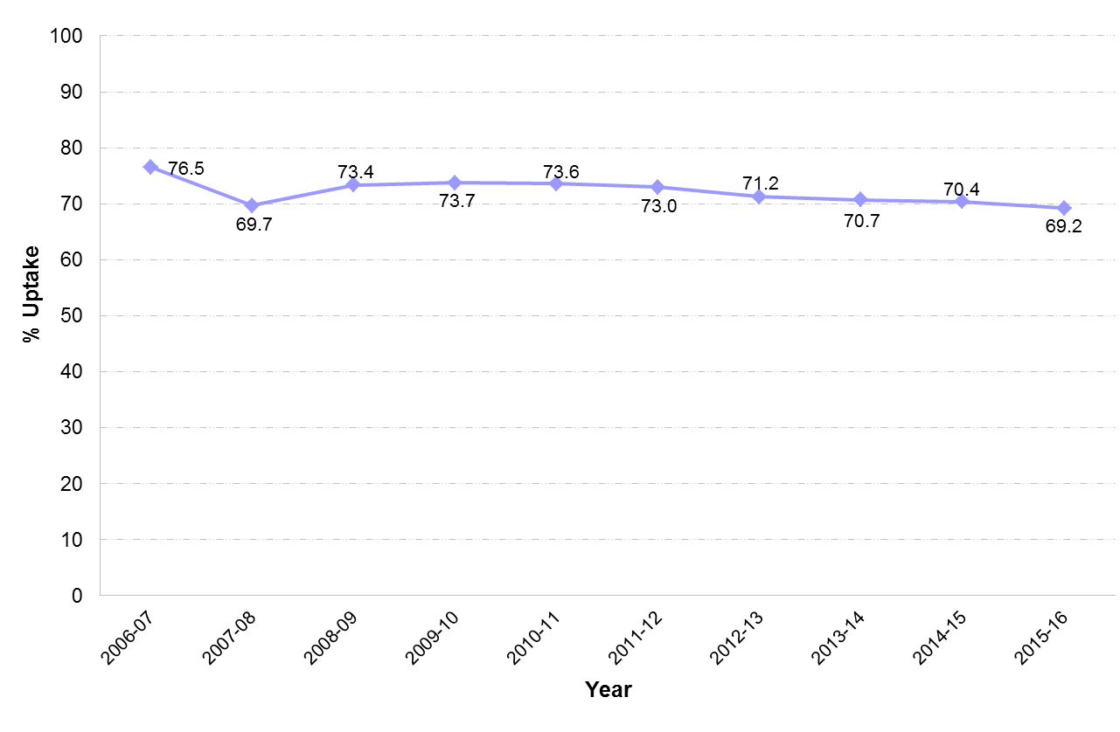
Cervical Screening

Slide 8
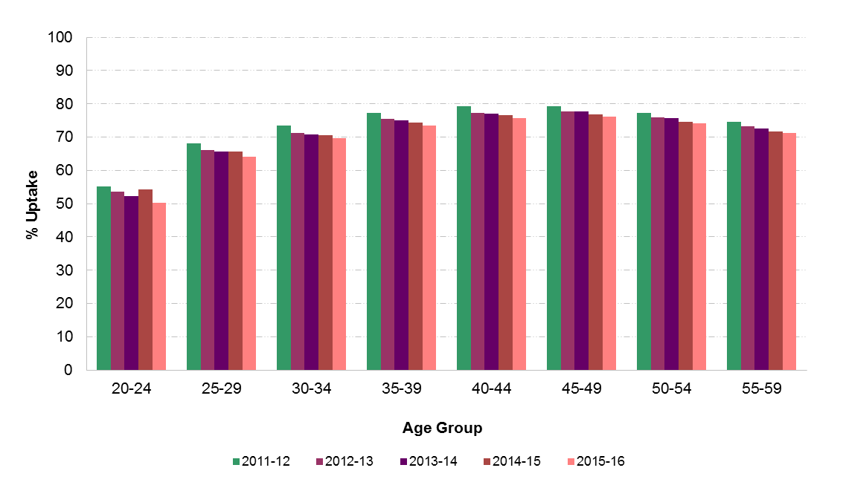
Cervical Screening

Slide 9
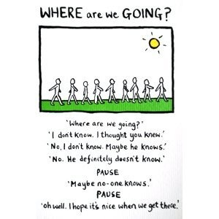

Slide 10
Screening Inequalities Fund
Supporting screening services to accelerate development, testing and spread of ideas and innovation in population based cancer screening
Overall aim
Primary contributing factors
Intervention factors
Required change Test of Change
At local level Supported by CS
SG Implementation activity factors
Strong engagement with PC
Enable Development and testing of effective new screening interventions through CS
Increased awareness and understanding of screening,
Improving Population Health
Screening is involved in local strategic planning
Theme 1: Emotional Barriers
Increased participation in screening from hard to reach groups
Facilitate a climate for change in Screening
People can access screening services at the right time through effective, sustainable screening programmes improving our ability to detect cancer at an early stage.
Our experience as participants in screening is enhanced
Promote an Improvement based Approach
Screening services meet peoples needs
Theme 2: Cognitive Barriers
Communication and Engagement
People are better informed and empowered to participate in screening
Increased use of Technology to inform and empower people
Accelerate spread through shared learning and networking
Screening evidences reduced variation, harm and waste
Theme 3: Practical Barriers
Draw together learning and integrate with other Screening Programmes (other appropriate activities)
Screening Workforce are improvers and innovators
Screening better addresses Health Inequalities
Change is informed by local data and variation in outcomes and practice
SSC/ Screening Programmes
Screening services better contribute to Improving Population Health
Primary Care
Screening Inequalities Network
Our Screening Infrastructure – physical and digital is improved
Screening services manage Risk Better
Community
DCE
Key Screening Inequalities Programme 6.3.17 V.1
ScreeningVision
Screening Outcome
Realistic Med
E-Health

Slide 11
Screening Inequalities Fund
Supporting screening services to accelerate development, testing and spread of ideas and innovation in population based cancer screening
Increased awareness and understanding of screening,
Increased participation in screening from hard to reach groups
Theme 1: Emotional Barriers
Screening services meet peoples needs
Change is informed by local data and variation in outcomes and practice
Theme 2: Cognitive Barriers
Theme 3: Practical Barriers
Our Screening Infrastructure – physical and digital is improved
Increased use of Technology to inform and empower people
Screening Workforce are improvers and innovators

Slide 13
Supporting Workstream
Scottish Government
Scottish Screening Committee
Screening Inequalities Network
Operational group
Local Boards/Projects

Slide 14
Thank you! Sarah Manson sarah.manson@gov.scot

