Slide 1
Improving the reach of screening programmes
Insights from target audience research
March 2017

Slide 2
Research focus
Audience insights in respect of health screening, with a strong inequalities focus
exploring understanding, attitudes, motivators and barriers to uptake
informing development of information materials to encourage informed decision making around participation
providing direction for increasing accessibility and perceived relevance of materials
With the aim of improving reach of national screening programmes

Slide 3
Target audiences
strong focus on low uptake audiences for each programme
areas of high deprivation (SIMD 1 & 2)
appropriate gender and age profile
sampling both those who have, and those who have not participated
qualitative methodology
mostly in-depth interviews
in home
at least one hour
across a number of Health Board areas
approximately 60 – 80 respondents per project

Slide 4
Some common threads
the format and layout of information materials should instantly communicate an easy read
It’s boring. You pick it up and you flick through it and you say to yourself ‘When have I got time to read that?’... I’m not actually going to pick that up and read it... there’s too much.
(Cervical screening leaflet)
It gives you every bit of information, but I remember when I got handed it the first time, I just looked at it – it kinda scared me more because it seemed a bit overwhelming – I didn’t want to know.
(Cervical screening leaflet)
it is vital to keep it simple, short and direct
There’s too many numbers for the everyday woman that’s sitting down that gets that through the door. You just sit and look at the numbers and you go ‘to hell with that!’. You just put it down and never pick it up again!
(Breast screening leaflet)
statistics can be impactful, but only if immediately understood

Slide 5
Some common threads
the decision to participate or not is not simply a rational one
emotional barriers can be very strong
need to be acknowledged both in materials and at screening
crucial to engage at an emotional level
I don’t know much about it – just what my friends said…it’s sore and degrading, slapping your boobs down on that thing! They told her to strip off with no bra, and put it in a vice – one of my busty friends was really bruised!
(Breast screening)
family and friends can have a positive role to play
I just kept at him to do it… I read about how easy it was – it was just a scan, you get them when you’re pregnant… nobody’s going inside or anything.
(AAA screening)

Slide 6
Breast screening

Slide 7
Breast screening
Good levels of awareness of breast screening programme and a sense of “knowing” what it’s about
HOWEVER
Minimal awareness of the Marmot review or any controversy around benefits and risks
decision making tends to be automatic or intuitive / emotional rather than based on weighing up pros and cons
barriers to participation did not stem from confusion over the risks, but rather negative associations with the screening process

Slide 8
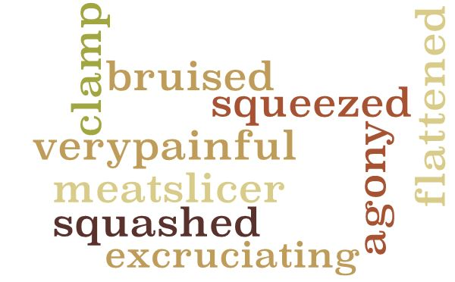
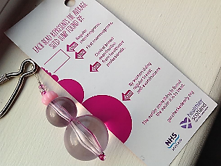
Breast screening
Fear of process
urban myths – depends on size of breasts
bad experience can deter from future attendance
Fear of result
can view as death sentence
benefits need to directly reference lives saved,
not just early diagnosis
Absence of symptoms
can lack personal relevance
important to reference
tiny lumps that can’t feel
Thingymaboob has strong impact – benefit becomes evident
Embarrassment
body image
indignity of being naked
especially older women

Slide 9
Cervical screening

Slide 10
Cervical screening
Cervical cancer and the screening programme not strongly on radar, particularly for younger women
limited awareness of purpose and benefits of screening
poor understanding of the link with HPV
assumes low priority and little sense of importance
unclear about personal relevance
older and lesbian women (sexual intercourse)
younger women (some link to promiscuity)
absence of open discussion – sense of something ‘hidden’
focus on perceived risks: a strong negative association
“That put me off! If that’s how you get a smear test, then I’m very, very sorry – no thanking you!”

Slide 11
Cervical screening
Fear
physical discomfort / pain
emotional vulnerability
any bad experience strengthens barriers
hearsay around very painful smears needs to be openly addressed
recognised as a real fear
(tonally) not dismissed as ‘not a big deal’
Embarrassment
humiliating
link with STI testing
strong sense of invasion of privacy (older women)
emotional concerns should be acknowledged
treated empathetically
cannot be overcome simply by stating the benefits of screening

Slide 12
Bowel screening

Slide 13
Bowel screening
Good levels of awareness of the bowel screening programme,
but bowel cancer not on radar
easy to push aside as not of great significance
not openly discussed, especially amongst men
associated stigma for some
key barriers relate to the screening process
viewed as dirty, unhygienic, disgusting
“It’s one of these probably taboo subjects, nobody talks about it…”
“Just the thought of it. It’s disgusting! Having to look at your own poo and put it in an envelope. No!”

Slide 14
Bowel screening
New QFIT test has potential to overcome a key barrier
only one sample!
looks simple to do
cleaner / less repellent process
“Ohh, like this! This is excellent, and it’s such a small sample compared to what the original one was!”
Key, simple statistics can indicate importance or provide reassurance
‘bowel cancer is the third most common cancer in Scotland’
‘9 out of 10 people will survive if bowel cancer is found and treated early’

Slide 15
AAA screening

Slide 16
AAA screening
Limited awareness of both the condition and the screening programme
“Once I’d read it, I had no real questions that I needed to ask anybody. That’s what persuaded me to just go and try and do something about it.”
the materials succeeded in addressing rational and emotional needs
increased understanding of AAA
strong sense of self relevance
even amongst DNAs
enabling informed decision making at an individual level

Slide 17
AAA screening
Male screening not on radar – can be easy to dismiss when arrives out of the blue
upfront, direct messaging very important
personal relevance and importance
tonally, an invitation rather than a direction to attend
Important to identify the risk – provide rationale for screening and consideration
potential seriousness of rupture
lack of symptoms
ease of screening
“It [diagram of aorta] shows that if anything happens to the aorta, you have slim chances of survival… It’s not too scary – it’s got to have a punch to it.”

Slide 18
Key learnings

Slide 19
Key learnings
short and direct
key relevant facts, not detail
consider lack of interest in topic and reading resources
don’t assume reading from beginning to end
Make information immediately accessible
Relevant information ‘in the hand’ is more likely to receive attention
unlikely to proactively seek out online unless have an interest
personalised formats have greater impact e.g. letter
The invitation letter has an important role to play
increases accessibility by highlighting key messages
particularly for those audiences less inclined to engage with more detailed information

Slide 20
Key learnings
create context
define target
clarify decision to be made
what is involved?
what next?
direct call to action
The message hierarchy is key
Listing of screening benefits is not sufficient to encourage uptake
emotional concerns present the strongest barrier
these need to be directly and honestly tackled
Emotional reassurance can aid resonance
encouraging/positive tone, but conveying importance
testimonials can help to ground information in the real world
increased self relevance

Slide 21
Key learnings
Service experience has greater impact than any communication
bad experiences (or stories of them) have a strongly negative impact on uptake
consistently empathetic engagement is vital
Cultural context and social norms play a role
important to raise awareness of relevance and importance of individual programmes
normalisation can aid engagement
Targeted priming prior to receipt of the invitation can help to contextualise
local activity to support arrival of invitation
putting it on the agenda

Slide 22
Thank you
Scott Porter Research & Marketing Ltd
31 Bernard Street
Edinburgh
EH6 6SH
Tel: 0131 553 1927
www.scottporter.co.uk
Menekse Suphi, Managing Director
menekse@scottporter.co.uk

