Slide 1
Addressing Health Inequalities in Scotland – lessons for screening
Screening and Inequalities Event
14 March 2017
Dr Andrew Fraser

Slide 2
Commitment in the Cancer Plan 2016 to tackle inequalities
What do we mean by health inequalities?
Health inequalities are:
Unfair differences in health within the population across social classes and between different populations
These unfair differences:
Are not random, or by chance, but largely socially determined
Are not inevitable.

Slide 3

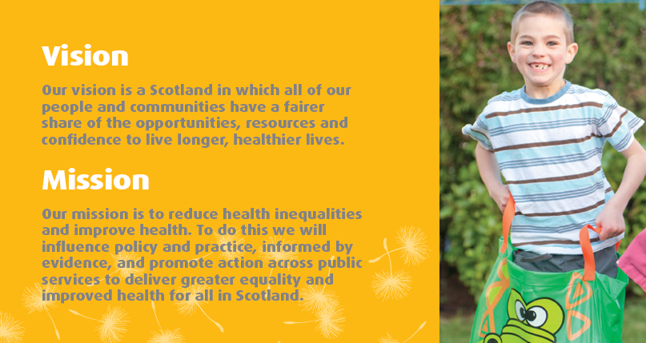
NHS Health Scotland, Our vision and mission
Our Strategy 2012-17:
“A FAIRER HEALTHIER SCOTLAND”

Slide 4
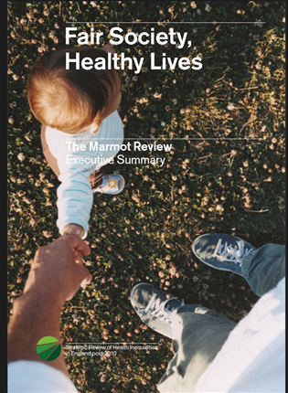


Slide 5
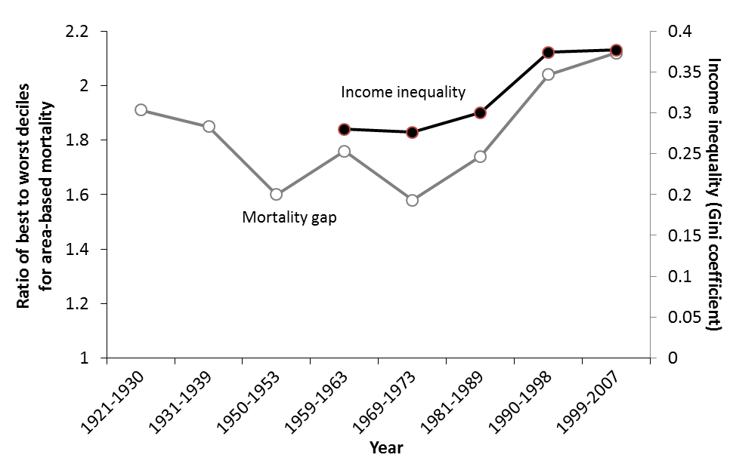
Mortality gap between local authorities and income inequalities in GB 1921-2007
(Source: Thomas & Dorling 2010, IFS 2012)

Slide 6
These data have been updated using the ScotPHO profiles published in June 2015 comparing the life expectancies in Broomhill (close to Jordanhill station) and Parkhead & Barrowfield (close to Bridgeton station) intermediate zones.

Slide 7
Screening & Inequalities
Inequalities persist, across health, economic and social dimensions of our lives
Everyone has the right to achieve the highest attainable level of health
Inequalities matter – it means years of difference off the lengths of our lives, and expectation of a long and healthy life
We can take action to narrow the gap, lessen the gradient

Slide 8
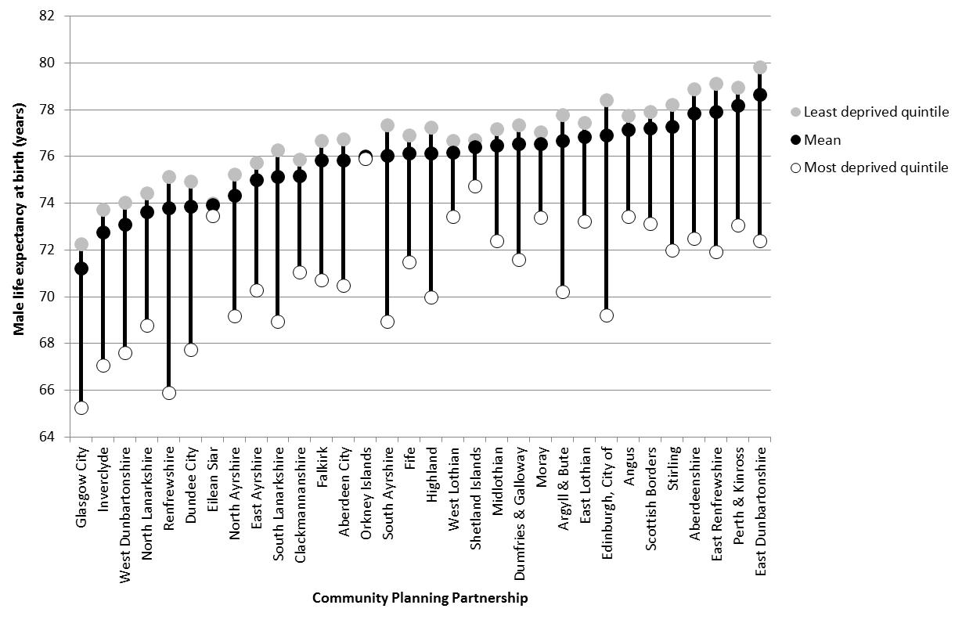
8

Slide 9
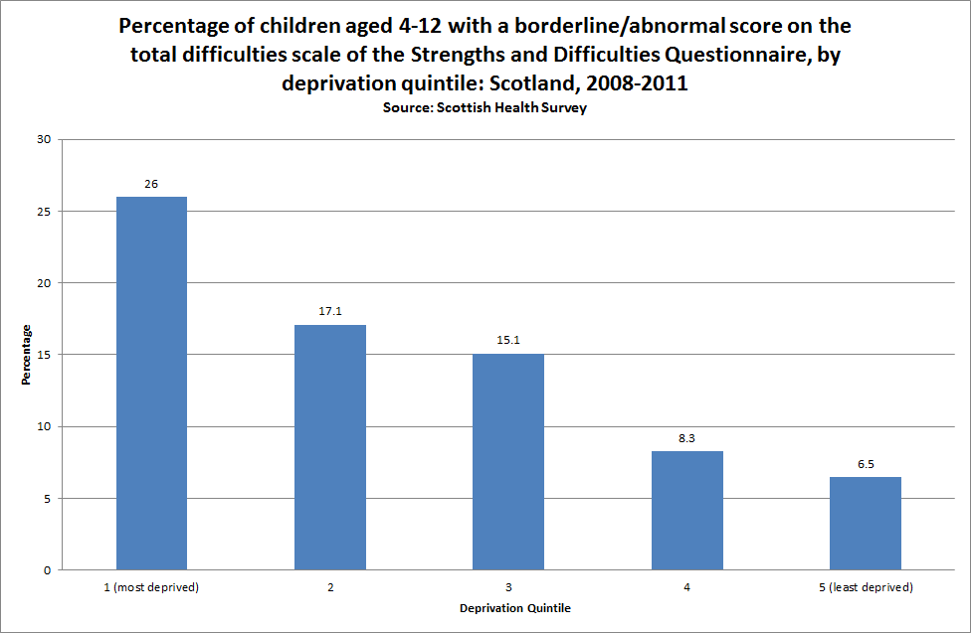
Inequalities remain
Asking evidence-informed questions about screening….

Slide 10
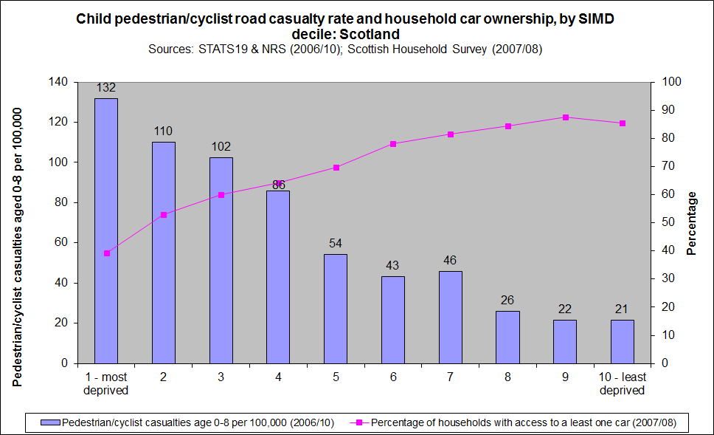
Inequalities remain

Slide 11
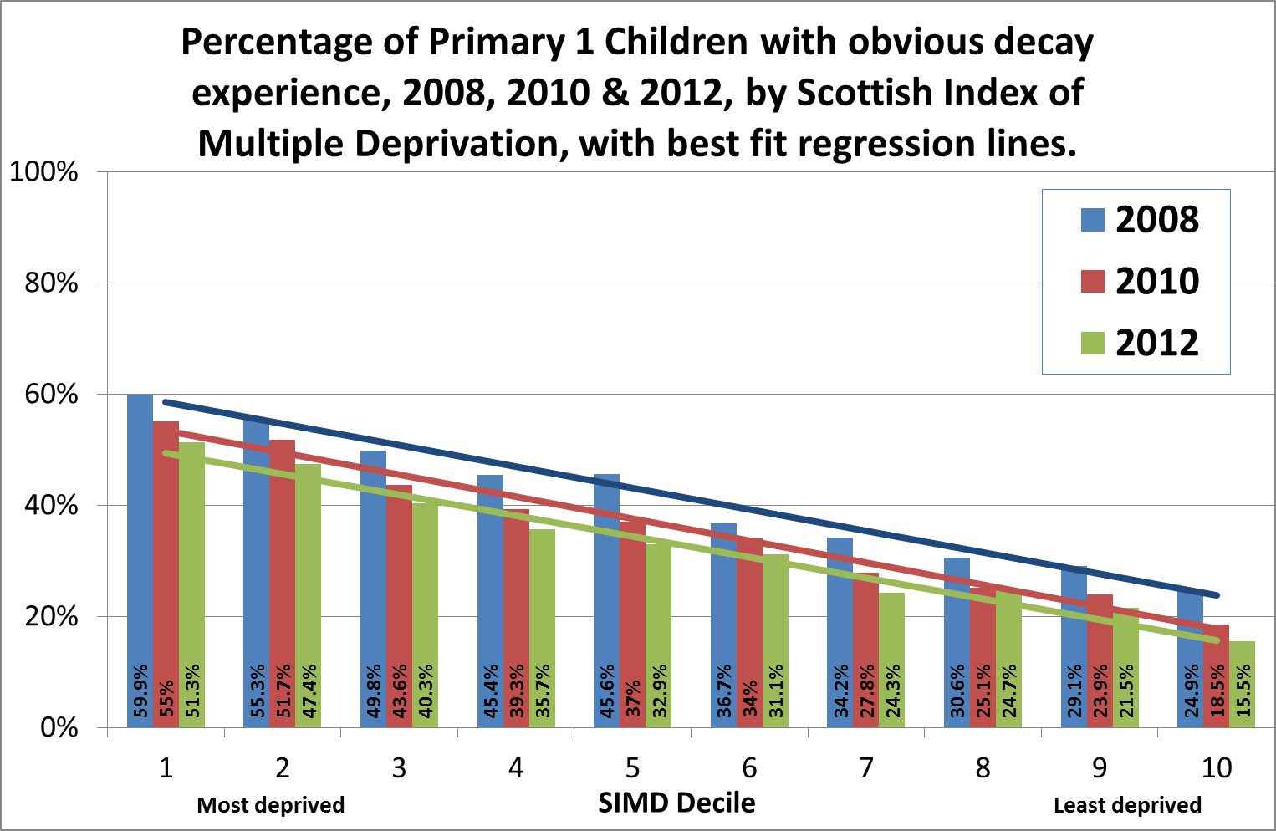

Slide 12
Bowel Screening
Overall uptake of bowel screening (%) by sex and deprivation category
Nov 2013 to Oct 2015.

Slide 13
What about screening?
Access
  Neonatal and pregnancy – almost universal
  Cancer, pre-cancer and AAA – varies
Follow-through
  Varies, inevitable further contact beats an optional patient journey
Outcome
  Very strong pattern – social pattern to preventable cancers; less marked social pattern to non-preventable cancers

Slide 14
Cancer Survival study
MacMillan study using ISD Scotland data – published February 2017
Six cancers – of the prostate, breast, head & neck, colorectal, liver, lung
Survival until from 2004-08 until 2013 showed gaps for all, apart from lung cancer which was poor for all people, wherever they stayed.
Solutions:
  Early detection and screening?
  Tackling Poverty?
  Inequalities in housing, education, employment, justice….

Slide 15
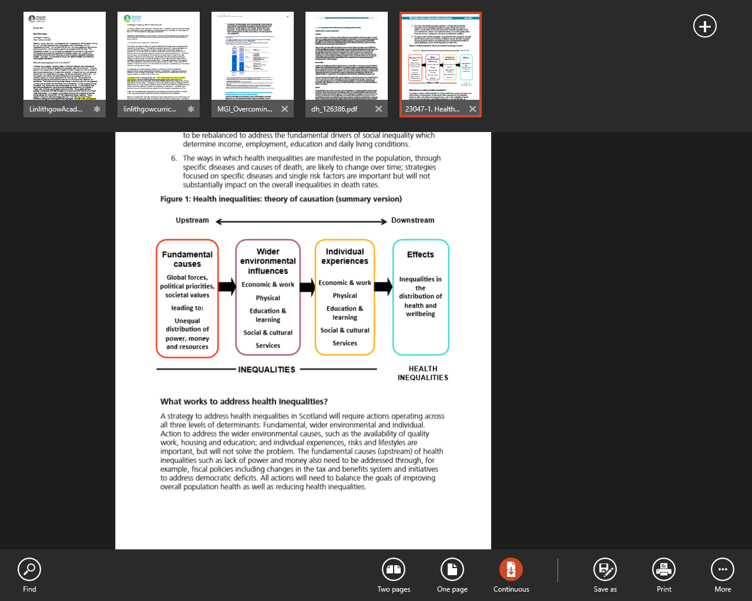

Slide 16
What causes health inequalities?
Inequalities in income, resources and power
Health behaviours (e.g. smoking and alcohol), taking part in health care programmes (eg. screening) or individual skills (e.g. parenting or employability) offer only very partial and incomplete explanations
Sources:
Commission on Social Determinants of Health. 2008. Closing the gap in a generation: Health equity through action on the social determinants of health. Final Report of the Commission on Social Determinants of Health. Geneva, World Health Organization.
Equally Well Policy Review. Edinburgh, NHS Health Scotland, 2013.
McCartney G, Collins C, MacKenzie M. What (or Who) causes health inequalities: theories, evidence and implications? Health Policy 2013; 113: 221– 227.

Slide 17
What do we do to tackle Inequalities?

Slide 18
Human Rights Based Approach
Participation – people take part in decision making and have a voice; and; policies and practice support people to participate in society and lead fulfilling lives
Accountability – organisations and people are accountable for realising human rights
Non-discrimination – everyone has the same rights (regardless of their ethnicity, gender, income, religion for example)
Empowerment – to give power to people, communities and groups need to know and claim their rights in order to make a difference
Legality – all decisions should comply with human rights legal standards

Slide 19
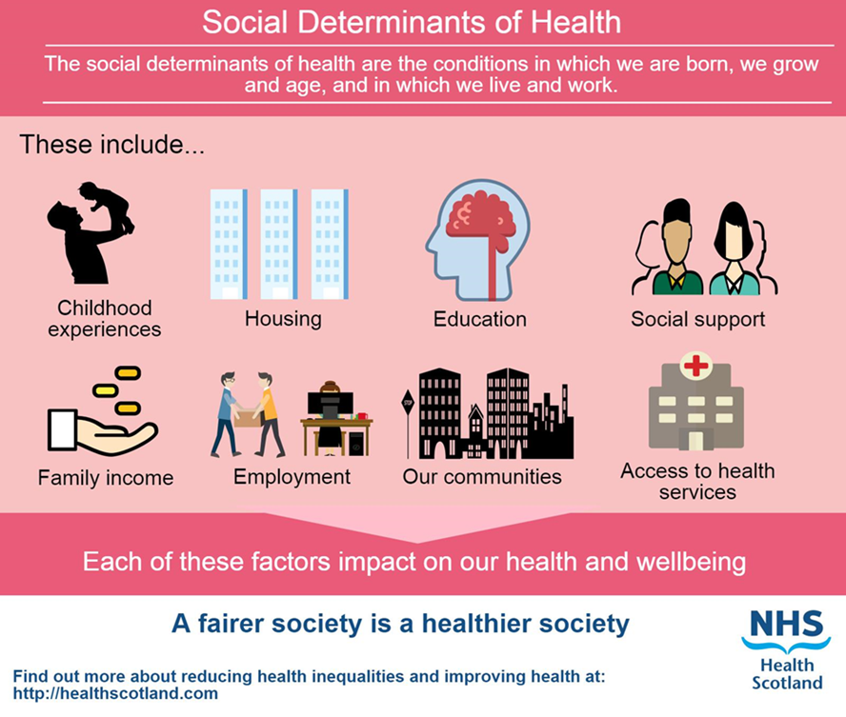
The public health response: joined up, strategic and human rights based
Look at the pattern as well as the screening programme
Link up with other sectors – health charities, third, other statutory, private
Need action across all social determinants of health and at structural, environmental and individual level

Slide 20
What is most and least effective in reducing health inequalities?
Most likely to be effective
Structural changes to the environment; legislation, regulatory and fiscal policies; income support, reduced price barriers; accessibility of public services, prioritising disadvantaged groups and individuals; intensive support for disadvantaged population groups; starting young.
Least likely to be effective
Interventions reliant on people opting in; information based campaigns; written materials; messages designed for the whole population; interventions that involve significant price or other barrier
Notes:
20

Slide 21
Addressing health inequalities
Fundamental causes | Policies that redistribute power, money and resources Social equity and social justice prioritised | Living wage Creating employment
Wider environmental influences | Use of legislation, regulation, standards and fiscal policy Structural changes to the physical environment Reducing price barriers Ensuring good work is available for all Equitable provision of high quality and accessible education and public services | Housing quality standard extended to private rented Place standard Regulate retail outlets
Individual experiences | Equitable experience of socio-economic and wider environmental influences Equitable experience of public services Targeting high risk individuals Intensive tailored individual support Focus on young children and the early years | Training – culturally/inequalities sensitive practice Linked public services for vulnerable/high risk individuals

Slide 22
Interventions and improvements – a selection
High quality information materials required to support informed choice (benefits and risks)
Health Inequalities Impact Assessments (HIIAs) – to help tailor and target information to optimise uptake
Growing the evidence base around effective interventions:
One to one education with particular groups (BME groups)
Primary care/Health Professional endorsement
Flexible service provision e.g. pop-up/opportunistic clinics

Slide 23
Interventions and improvements – a selection (2)
What is the experience of a person you want to come for screening?
Do we listen – do we respond and change to improve?
Have we asked people who don’t turn up?

Slide 24
Asking evidence-informed questions about screening….
Do people trust us?
Is it facts, or feelings?
What would a marketing agency, and community group, say?

Slide 25
Poor Literacy hits health Medical chief’s warning over failing campaigns
The Times, Saturday 11 March 2017

Slide 26
Conclusion
Screening and Inequalities
Screening access/uptake, experience and outcomes have clear and consistent social patterns
We have to be sensitive to, and understand, and respond to, the circumstances of people’s lives
We can design services better with the outcome in mind – the health and the human outcome
#scotcancerscreening

Slide 27
Addressing Health Inequalities in Scotland – lessons for screening
Dr Andrew Fraser
andrew.fraser2@nhs.net
14 March 2017

